Slide 1
County New Financial Managers Orientation

Slide 2
New Financial Managers Orientation
SPARC Portal
SPARC Website
SPARC Reports
Time Studies
Cost Pools
SPARC Claim Reviews
Key Points
Questions
^{dcf.wisconsin.gov}

Slide 3
SPARC Portal
Using SPARC Portal Step by Step
dcfsparc.wisconsin.gov
Account Set Up
Create entries
Submit monthly report
Verify Submission
Revising Reports
^{dcf.wisconsin.gov}

Slide 4
SPARC Portal
New User Account Set Up
Visit DWD Wisconsin Logon Management System (User Acceptance Agreement) and create Username (WIEXT ID) and password that you’ll use for SPARC portal: https://accounts.dwd.wisconsin.gov/
Fill out the SPARC Authorization Form
http://dcf.wisconsin.gov/files/forms/doc/5157.docx
Submit the form to DCFFinanceGrants@wisconsin.gov
Form requires supervisor’s signature
DCF Finance will email a new user after the SPARC account is set up
Current turn around time is 3~5 business days
^{dcf.wisconsin.gov}

Slide 5
SPARC Portal
User Account Close Out
Fill out the SPARC Authorization Form and submit to DCFFinanceGrants@wisconsin.gov
Make sure to check ‘Inactivate Access’ box on section #8
If you don’t know WIEXT ID that you want to inactivate, leave it blank
DCF will check the username
Supervisor signature is required
DCF Finance will email supervisor listed on the form when the account is closed
^{dcf.wisconsin.gov}

Slide 6
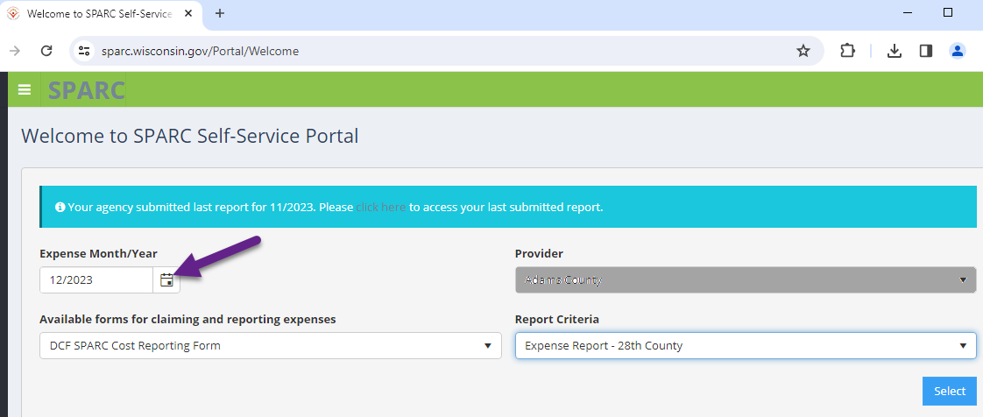
SPARC Portal (https://sparc.wisconsin.gov)
Chrome is the Preferred Browser
Expense Month/Year will default to current month. Be sure to update before selecting form.
^{dcf.wisconsin.gov}

Slide 7
SPARC Portal
Selecting Expense Month, Report Form and Report Criteria
Select Expense Month
Only available months to submit expenses will be shown in the calendar
90 days (or 3 months) to revise the reports
Select any month within a quarter to submit Employee Count Report
For example, if you want to file Q2 Employee Count Report, you can select April, May, or June
Select a Form
All available forms for your agency are in the drop down list
Select a Report Criteria
If there’s only one choice for the report criteria, it will automatically fill in when you select the form
^{dcf.wisconsin.gov}

Slide 8
SPARC Portal
Report Submission
Session remains active for 8 hours
Save/Submit report as often as you’d like
Data will over-write your last submission
Will be able to print as you go
All saved expenses will be shown when you open the form again
Can’t find line code on the form?
New contracts are entered in SPARC Portal after DCF signs off internally to send out procurement contracts to agencies
Contact DCFFinanceGrants@wisconsin.gov if you don’t see code in portal
^{dcf.wisconsin.gov}

Slide 9
SPARC Portal
Revising Submission
When the month you need to revise is still available in portal
Select month
Select form and report criteria
Last submitted expenses are already entered
Revise the amount to corrected total
Hit Save/Submit
You can still revise even if you received payment
SPARC will recalculate the difference and add/subtract difference from the next payment
When the month you need to revise is not available in portal
Revise in the month that is still open in portal
If expense needs to be entered in particular month, contact DCFFinanceGrants@wisconsin.gov
^{dcf.wisconsin.gov}

Slide 10
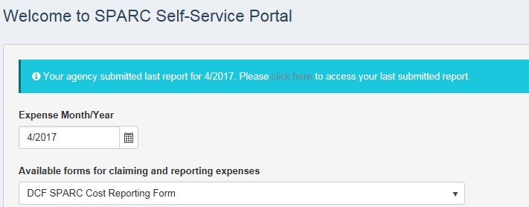
SPARC Portal
Verifying your submission
After submitting the report, SPARC portal will display a successful message and choice of either printing report or going back to the welcome page
If you don’t receive the message, your submission didn’t get saved correctly
You can also verify the submission by selecting month, report form and report criteria to open the form or you’ll see a blue line with a link to print PDF form from the last submitted report
^{dcf.wisconsin.gov}

Slide 11
SPARC Website
SPARC Website: https://dcfsparc.wisconsin.gov/
Check SPARC System and Website Updates on Home Page
Use Search Box to find what you are looking for
Programs Quick Links
Allowable Cost Policy Manual
Child Care Information
Audit Information
RMS/RMTS
Links for most commonly used sites:
RMS & Employee Count: https://dcf.wisconsin.gov/rms
RMTS: https://dcf.wisconsin.gov/rmts
CC IM Eligibility %: https://dcf.wisconsin.gov/eligibilitypercentages
^{dcf.wisconsin.gov}

Slide 12
SPARC Reports
SPARC Statewide Reports Available on SPARC Website
All reports are updated daily at 5 am
If refreshed date is not today’s date, you need to clear browsing history
Available Reports
Contract Balance Information
Contract Balance By Agency - How much of contract left for my program?
Expense Information
Monthly Detail for each calendar year – Did I report expense last month?
Supplier Reconciliation Report (YTD Report) - What’s my YTD reported expense for the program?
Agency Contract Detail – YTD reported expense and payment side by side
Expenses by Class Code – How did I break down the expenses when I reported?
Payments
Bank Deposits Reconciliation – Which program received a payment?
Calendar Year Payments at a Glance – I want to see payments by reporting period instead of payment date
RMS Cost Allocation Report – How did my shared cost get allocated for RMS?
^{dcf.wisconsin.gov}

Slide 13
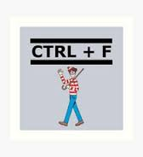
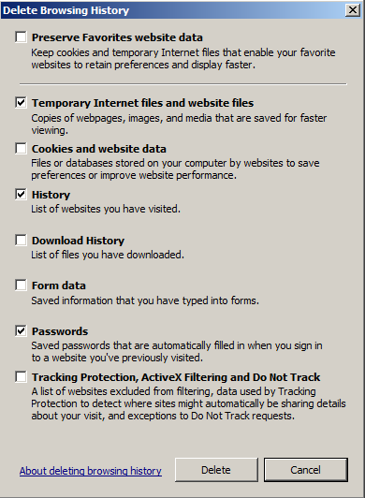
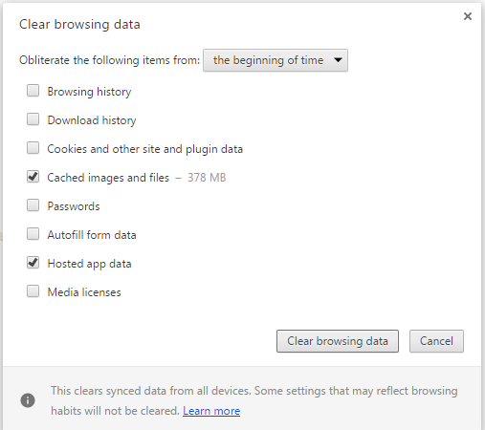
SPARC Reports
Tips and Tricks to use SPARC Reports
Instead of scrolling to find your agency, use Ctrl + F to find
Supplier Name is exactly the same as what you see on SPARC Portal form
You can use supplier ID to find your agency too
Check refreshed date
If refreshed date is not today’s date, you need to clear browsing history
Internet Explorer:
Chrome:
^{dcf.wisconsin.gov}

Slide 14
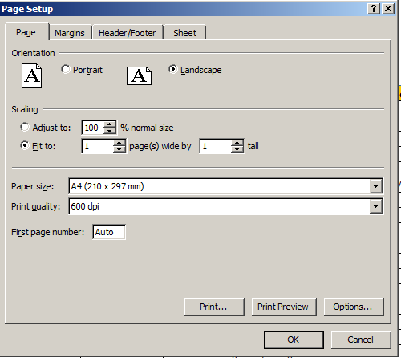
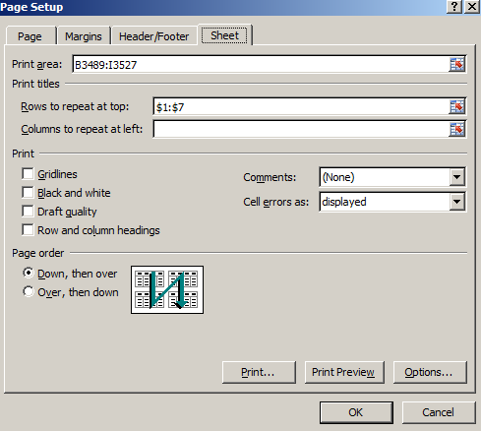
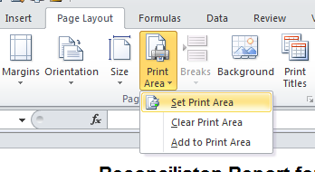
SPARC Reports
Tips and Tricks for using SPARC Reports
Printing reports – Becoming an Excel Expert!
Open Page Setup
Select Scaling to Fit to: 1 page wide by 1~2 page tall (depending on area)
If you need the report header, select Sheet tab
Click icon from Rows to repeat at top:
Select the rows you want to add and click to get back to Page Set Up screen and hit OK
Highlight the area you want to print
In Page Setup ribbon, click Print Area and select ‘Set Print Area’
Preview and Print
#2
#4
#5
#7
^{dcf.wisconsin.gov}

Slide 15
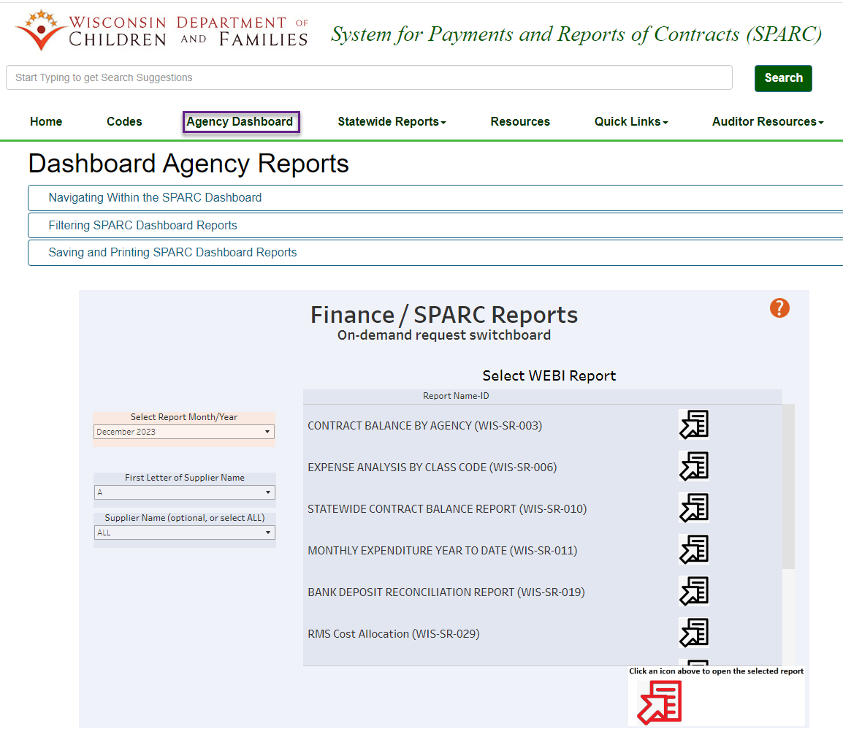
Agency Dashboard Reports
6 reports currently available – data same as Statewide Reports
Can run report for specific agency
Reports can be saved as PDF or Excel
^{dcf.wisconsin.gov}

Slide 16
SPARC Payments
ACH Remittance from State
When DCF runs payments from SPARC, ACH Remittance Notice gets send out to designated email address for each agency
Can designate up to 2 email address (60 characters total or less including ; to separate addresses) per agency
All DCF SPARC payments will have invoice numbers that start with ‘DCFSPARC’
For Example, Invoice# DCFSPARC0000071926190613
All cashiers need to become familiar with the Bank Deposit Reconciliation Report
Unknown payment from the State?
Contact DOA: WIVendors@wisconsin.gov
^{dcf.wisconsin.gov}

Slide 17
Employee Count (FTE)
Who goes into which area?
The rule of thumb is follow the funding when you are not sure
Payroll is a good place to check
Employee Count should be based on the 15th of the second month of each quarter
Q1 = 2/15, Q2 = 5/15, Q3 = 8/15, Q4 = 11/15
IM/CC count should match the RMS roster number
If Child Support (CS) is within Human Services, CS count on employee count report should match with monthly CS expense form
^{dcf.wisconsin.gov}

Slide 18
Time Study
What is a time study?
Method of getting a statistic of how many hours of work is spent on a specific program within a certain period
Types of time study that agencies currently have for State
Random Moment Sampling (RMS)
Used for Economic Support (IM/CC)
Programs that funded by
DHS – Medicaid, BadgerCare, Food Share, etc. about 95% of programs
DCF – Child Care
DOA – WHEAP
Random Moment Time Study (RMTS)
Used for Social Service for DCF to claim Title IV-E
Child Support Random Moment Sampling (CS-RMS)
Used for Child Support for DCF to claim Title IV-D
^{dcf.wisconsin.gov}

Slide 19
Cost Pool
What is cost pool?
A pool of expenses to run programs from the time study
State allocates cost pool by applying the time study statistic to claim Federal reimbursement for each program
Agencies are required to report the following cost pools to the State
RMS for IM/CC (TANF)
All Program Shared (AMSO) – SPARC Line Code 4076
IM/CC Cost Pool – SPARC Line Code 4320
RMTS for Title IV-E (Title IV-E)
Social Service – SPARC Line Code 3301
Eligibility Determination – SPARC Line Code 3321
Child Placing Agency – SPARC Line Code 3329
Social Service Indirect – SPARC Line Code 3683
^{dcf.wisconsin.gov}

Slide 20
IM/CC Cost Pool
Cost Pool Overview for RMS
Shared Cost (AMSO) #4076 – Agency costs that cannot be specified to program
Agency’s share of indirect cost
Director’s salary and fringe
Finance and HR staff and related expense
Space related cost
General Admin Cost such as mail & communications
All other overhead costs
IM/CC Cost Pool #4320 – All cost to run IM/CC
Salary and fringe benefits of all individuals on RMS roster as well as their direct supervisors
Include travel, supplies, services & equipment costs directly associated with these employees
Any costs that benefit two or more IM/CC programs within the IM/CC functional area
^{dcf.wisconsin.gov}

Slide 21
IM/CC Cost Pool
What does the State do with RMS Cost Pool?
IM/CC
AMSO Applicable to IM/CC Programs
AMSO
#4076
Employee
Count Report
Child Support
Social Services
State allocation for the Feds Claim
Aging
Cost Pool
IM/CC
#4320
+
IM/CC
Reports from counties
IM/CC Cost Pool
DHS CARS
Reimbursements for each programs
Medicaid
x
Food Share
RMS
Statistics
DCF SPARC
Reimbursements for Child Care
#8000’s
Child Care
WHEAP
^{dcf.wisconsin.gov}

Slide 22
Children and Families Cost Pool
Cost Pool Overview for RMTS
Due Monthly by the 28th – payment of the Direct Cost Report may be delayed if Shared Costs and Employee Counts are not reported timely
3301 - Social Services Cost Pool: County costs associated with providing non-purchased Social Services
3321 – IV-E Eligibility Determination: Social Services or administrative staff costs associated with performing determination or re-determination of IV-E eligibility of a child placed in substitute care
3329 - Child Placing Agency: NET cost of payments to private Child Placing Agencies (CPA) for administrative functions for out-of-home care clients when agency supervises the foster home
Do not report maintenance costs for children placed with CPAs
3683 - Social Service Indirect: Report Social Services share of AMSO (enter the AMSO for positions listed on the RMTS roster for line 3301)
^{dcf.wisconsin.gov}

Slide 23
SPARC Claim Reviews
Random sample of SPARC Claims
Quarterly review of prior quarter’s claims
Federal requirement
Not an audit
Checking for general compliance
Don’t send personally identifiable information
Make sure amount on documentation sent matches the amount of the claim being reviewed
Email sent to Portal user that submitted claim
^{dcf.wisconsin.gov}

Slide 24
Key Points
Questions? Need training?
Email/Call us
Quick question
Longer discussion
Make an appointment to come visit
Be cautions about doing what another county does
Structure differences
System differences
They might be wrong
^{dcf.wisconsin.gov}

Slide 25
Key Points
For some programs DCF gets the funding (money) to pay you based on your reported expenses
For other programs DCF gets the funding based on the cost pools
RMS
RMTS
Cost pools are just as important as direct costs
^{dcf.wisconsin.gov}

Slide 26
Key Points
Payment Reconciliations are as or more important than portal submission
Why spend the time?
It’s your money
If something can go wrong, it will
Submit expenses in the wrong month
Forget to hit Save/Submit
Is your contract amount correct?
^{dcf.wisconsin.gov}

Slide 27
Communications
DCF will communicate with agencies by…
Email – We will use email address tied to the SPARC account
SPARC Website Home Page – Updates related to SPARC will be posted
SPARC Portal Log In Page – SPARC maintenance notices and information will be posted
Telephone - We will use phone number tied to the SPARC account
Child Support Bulletin Board – less likely to use unless information is only for Child Support
Agencies can contact DCF by…
Email – DCFFinanceGrants@wisconsin.gov is the primary contact address to reach DCF Finance
^{dcf.wisconsin.gov}

